Slide 1

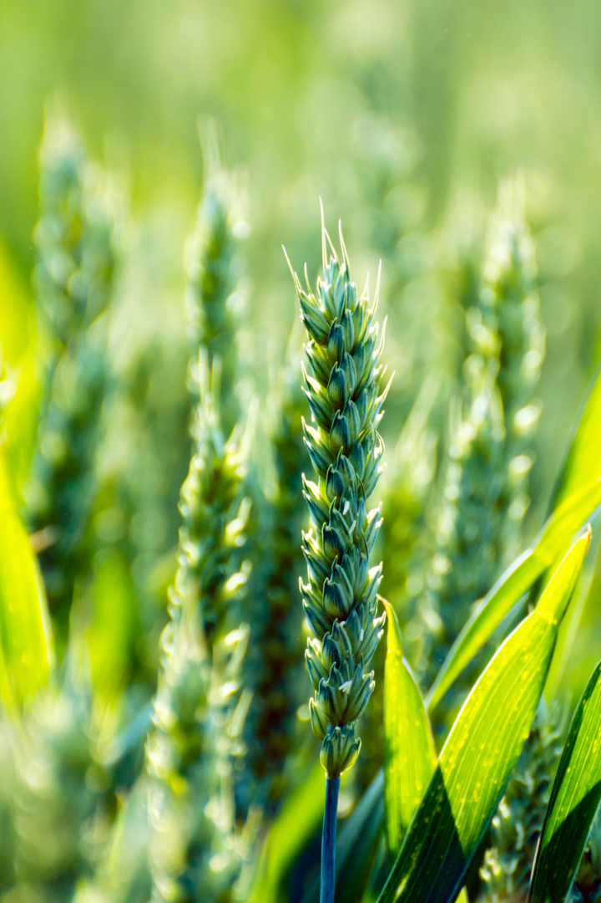

Agricultural Research for Citrus Disease Identification

Slide 2

Introduction to Citrus Plants
High in Vitamin C 🍊
Citrus plants are renowned for their high vitamin C content, making them valuable in the Indian sub-Continent, Middle East, and Africa.
Wide Range of Uses 🌍
These plants serve as raw materials in the agricultural industry for products like jams, sweets, ice cream, and confectionery.
Pakistan's Key Crop 🇵🇰
Citrus is Pakistan's most important fruit crop, with an annual production of around 2.5 million tonnes in 2018.

Slide 3

The Challenge: Citrus Diseases
1
Threat to Crop 🍂
Citrus plants are susceptible to diseases such as black spots, cankers, scabs, greening, and melanose, resulting in significant crop losses.
2
Traditional Methods Inadequate ⏳
Traditional disease identification methods are subjective, time-consuming, and expensive, underscoring the need for an automated system.

Slide 4

Problem Formulation
1
The approach for the identification of citrus plant diseases from images as a classification problem.
The goal is to develop a model that can detect and classify different disease classes based on citrus disease images.
2
The compare of various machine learning classifiers and a deep learning model, the CNN, in this paper.
Their deep learning model employs an optimal number of layers and parameters, enhancing accuracy and efficiency.

Slide 5

Related Work
1
Pioneering Research 🌐
2
Further Exploration Needed 📚
Previous research in citrus disease classification has utilized machine learning and CNN models, showcasing the potential of these approaches.
While advancements have been made, there is still room for improvement, particularly in parameter and layer selection in neural network models.

Slide 6

Our Contributions
1
Utilizing Cutting-edge CNN 🚀
Employing a state-of-the-art CNN model to classify citrus diseases into different classes, enhancing accuracy and reliability.
2
Optimization for Superior Performance ⚙️
The deep learning model incorporates multiple layers and optimal parameter settings, resulting in improved disease recognition based on visual symptoms.

Slide 7
Comparative Analysis
Accuracy Comparison In Terms of Machine Learning
Proposed CNN Model
SVM
KNN
Accuracy
94.55%
82.1%
82.91%
2. Accuracy Comparison In Terms of Deep Learning
Proposed CNN Model
Baseline#1
Baseline#2
Accuracy
94.55%
87.28%
91.75%

Slide 8
Results and Conclusion
1
Future Directions
2
Limitations
1. Explore diverse plant disease datasets to enhance the model's capabilities.
1. The CNN model's performance may vary when applied to different datasets or new disease classes.
2. Investigate the integration of transfer learning techniques to leverage pre-trained models for improved disease recognition.
2. The reliance on image data may limit the model's effectiveness in cases where other forms of data are required.
3. Explore the use of ensemble methods to further improve classification accuracy.
3. Usages of only one Deep Learning Model.
4. Develop a frame-worked Based IOT.

